Slide 1
PRAYER DIARY
2023

Slide 3
Cycle of Prayer
For all Christians, daily prayer is an essential part of life. This Cycle of Prayer is designed to fuel your prayers so that you can do the most practical and spiritually powerful thing any Christian can do – asking God to act!
This version of the Prayer Diary provides a forty-day cycle of prayers across the Diocese, covering parishes, pioneer ministries and diocesan organisations and agencies. Also included are things to thank God for, recognising the blessings he has poured out upon us.
Each page also includes contact details, so that you might reach out and encourage those you are praying for. We see this modelled throughout the New Testament, where the writers of the epistles not only tell others they are praying for them, but also include the content of their prayers.
For this reason, I bow my knees before the Father, from whom every family in heaven and on earth takes its name. I pray that, according to the riches of his glory, he may grant that you may be strengthened in your inner being with power through his Spirit, and that Christ may dwell in your hearts through faith, as you are being rooted and grounded in love.
Ephesians 3:14-17
Bishop Matt Brain

Slide 4
Our Diocesan Prayer
Generous God,
We thank you for the Diocese of Bendigo, the beautiful mountains, hills, plains and native forests that is our environment.
Bless the cities, towns and rural areas, the parishes, congregations and agencies in which we live and serve.
Give us vision, energy and hope to be a Missionary Church.
By the Spirit’s gifts, equip us to live the Gospel of Christ
and make us eager to do your will,
that we may share the joys of the whole creation.
We make our prayer
through Jesus Christ your Son, our Lord.
Amen.

Slide 5
Day 1
The Bishop of Bendigo
Again Jesus said, “Peace be with you! As the Father has sent me, I am
sending you.” – John 20: 21
The Right Rev’d Dr Matt Brain
Give thanks for
Our servant hearted clergy and lay leaders;
A wonderful registry team who have poured themselves out to serve the diocese throughout the difficult pandemic time;
That God continues to raise up clergy (newly ordained and experienced) to lead and care for his people.
Prayer points
That the world may know that we in the Diocese of Bendigo love Jesus by our love for one another;
For opportunities to bear witness to Jesus in private conversations and public forums;
That God will give us eyes to see where new congregations may be started in the communities which do not yet have one.
Contact
03 5443 4711
bishoppa@bendigoanglican.org.au
Also pray for:
Bendigo Diocesan Senior Leadership Team

Slide 6
Day 2
Pioneer Ministry in the Bicycling Community
Cycling by faith to be in the Bicycling community to be available and
obedient to the Leadings of God's Holy Spirit.
The Rev’d Edward Barkla
Give thanks for
The safety and wellbeing of the members of the Bendigo Bicycling Community;
The continued support of the pastoral care and monthly donation for making a difference in the carers needs.
The answered prayers and the hearts of the saints who join in seeking to be praying God's will be done in the bicycling community
Prayer points
Eyes of faith to see the hand of the Good Lord and be a witness of His glory kindness and loving care for the lost and broken hearted;
To be faithful in thought word and deed to be the witness God has planned and purposed for His honour and glory;
To be faithful in sharing the Good News of the Gospel in relief ministry across the parishes, in the bicycling community and where God may lead us to be for Him.
Contact
Rev’d Edward Barkla 0407840245 ebarkla58@gmail.com
Also pray for:
Lay ministries throughout the diocese

Slide 7
Day 3
Parish of Bendigo North
Including: St Luke’s White Hills and True North at St Clement’s Huntly
The Rev’d Glenda Templer
Give thanks for
The faithful witness of people past and present;
The communities of White Hills, Epsom and Huntly in which we minister;
Strengthened faith.
Prayer points
To continue to discern and respond to God's call to ministry in this place;
Continued growth in generosity and compassion;
Faithfulness as we seek to respond to human need.
Contact
03 5444 1875
bendigonorth@gmail.com www.bendigonorth.com
Facebook: BendigoNorthAnglicanParish
Also pray for:
Rural Deans

Slide 8
Day 4
Parish of Castlemaine
Including: Christ Church Castlemaine and St John’s Chewton,
The Rev’d Canon Ian Howarth
Give thanks for
Gifts of music in the parish: organist, pianists and choir;
The legacy of the past and significant sacred spaces in which to offer worship, prayer, meditation and places of solace and reflection.
Prayer points
For meeting the needs of regular worshippers, visitors and those seeking to join us and the needs of a diverse community;
Reaching out through music via choral work and regular concerts;
Seek to establish a community 'harvest lunch' to help meet needs of hunger, loneliness and build fellowship.
Contact
03 5472 1137
castlemaineanglican@bigpond.com www.castlemaineanglican.org
Also pray for:
Diocese of Ballarat

Slide 9
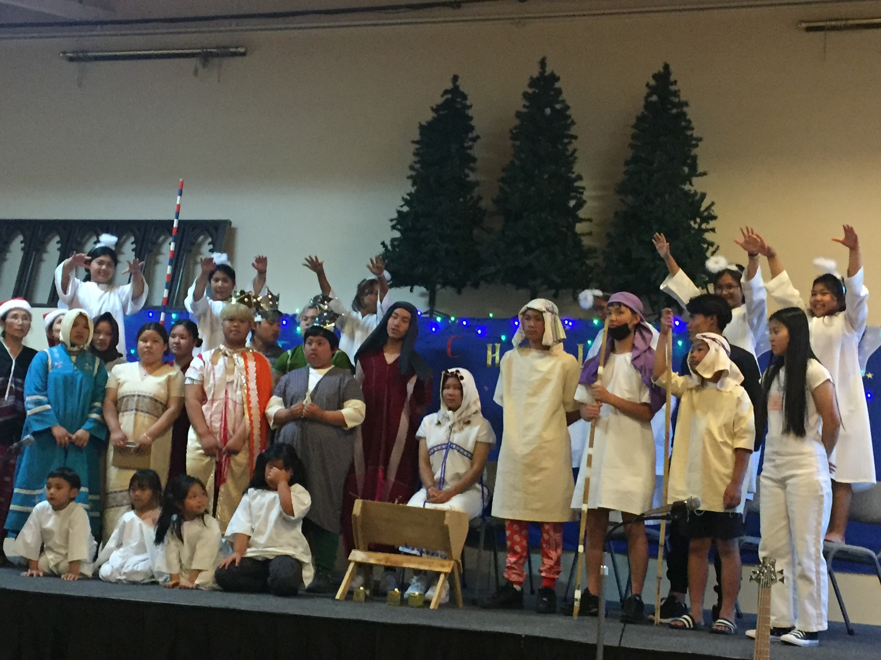
Day 5
St Paul’s Cathedral
Unless the LORD builds the house, those who build it labour in vain. Unless the LORD guards the city, the guard keeps watch in vain.
– Matthew 5: 14
The Very Rev’d Elizabeth Dyke
Give thanks for
The Cathedral clergy team: Dean Elizabeth, Baw Mu Htoo Bleh Dah Moo, Katy Lambert, Angela Lorrigan, Heather Marten, Roger Rich, Noel Richards, Suzannah Daniels, Peter Dyke, Ma Thae Bleh Da Moo;
Greater financial stability;
‘Growing into Healing and Wholeness’ ministry;
New community-focused ministries developing.
Prayer points
Sustainability of activities and outreach;
Developing new leaders and volunteers;
Karen language activities led by Reverends Baw Mu Htoo and Ma Thae;
Connections with other churches and groups, to grow the Kingdom of God.
Contact
03 5443 5061
office@stpaulsbendigo.org.au
Dean Elizabeth Dyke 0433 875 861 dean@stpaulsbendigo.org.au
Also pray for:
Anglican Church of Australia

Slide 10
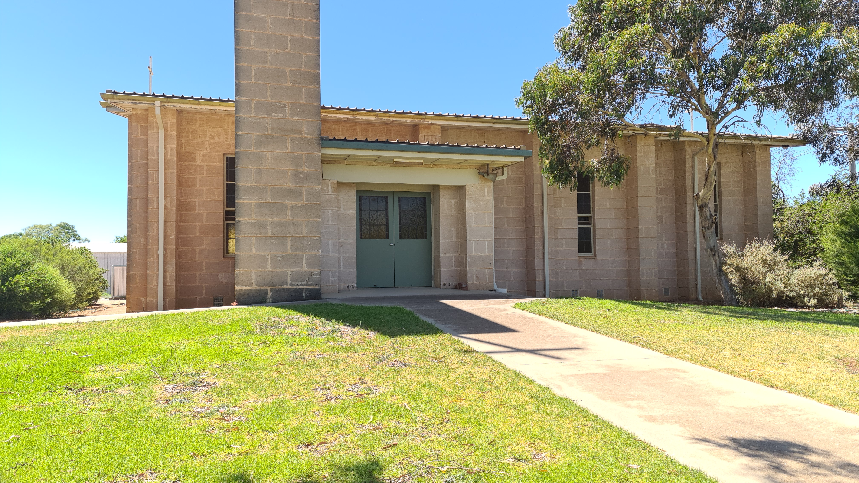
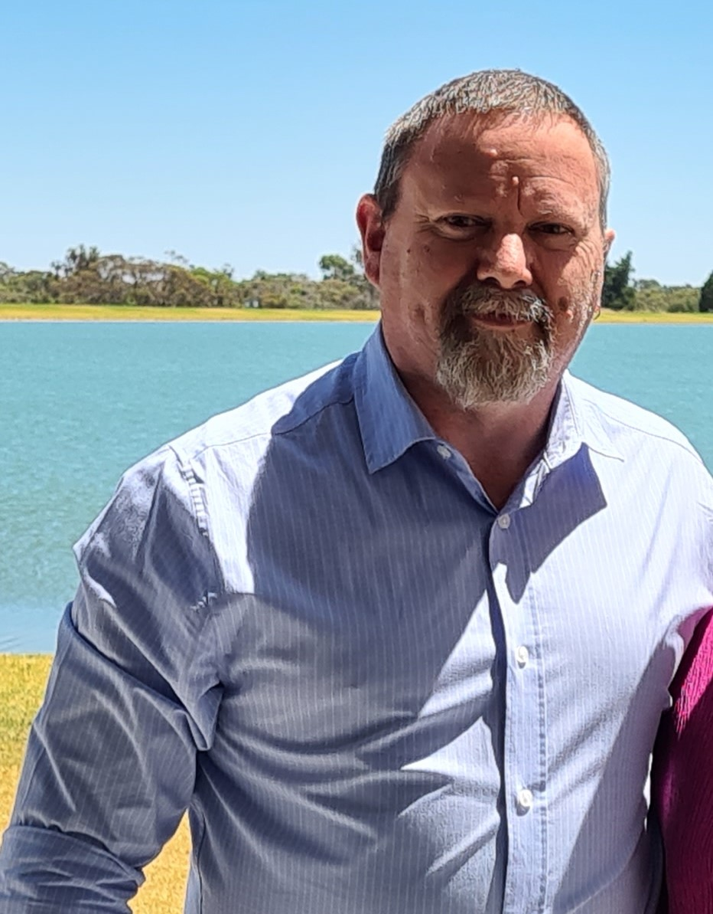
Day 6
Central Mallee Cooperating Parish
Including: Ouyen, Underbool, Walpeup,
Patchewollock and Murrayville.
Rev'd Steve Weickhardt (Mallee Missioner)
Give thanks for
Our reconciliation with our heavenly Father, strong hope in the risen Jesus, and the gift of the Holy Spirit;
The strong links our congregations have in the surrounding community to connect and invite into relationship with Jesus;
New ways of doing ministry to people who have not heard the Good News of Jesus.
Prayer points
Confidence and hope in sharing the Good News of Jesus;
Care and kindness for the isolated and vulnerable in our community;
Travelling mercies for the ministry team across the Mallee.
Contact
Rev'd Steve Weickhardt
0473 338 864 malleemission@outlook.com
Also pray for:
Diocese of North West Australia

Slide 11
Day 7
Parish of Charlton- Donald
Including: St Paul’s Birchip, St Martin’s Charlton, St George’s Donald and
Holy Trinity Wedderburn
The Rev’d Judi Bird
Give thanks for
Generosity of spirit of the Parish;
Resilience in life and prayer;
Faithful and assurance of God’s enduring love in all that they do and all that they are.
Prayer points
Pray for our Parish to continue to be good neighbours, faithful parishioners, loyal and active members of the communities in which they live and work and in the community of the church;
Pray that we continue, as those that have gone before, to regard our land as God’s land, as stewards of His bounty and conserve and improve it so that it will increasingly continue to give glory to Him.
Contact Rev’d Judi Bird 0435 593 359 judithblackbird@outlook.com
Also pray for:
Diocese of Bathurst

Slide 12
Day 8
Christ’s True Light Church
“Call to me and I will answer you, and will tell you great and hidden things that you have not known.” – Jeremiah 33:3
The Rev’d Simon Chan
Give thanks for
Provision for the needs of the church through the generous giving and tithes;
Smooth transition of the church into monolingual English Service and Mandarin Service;
Good leaders and members who are passionate for the Kingdom work;
God has put each one of us in this church for His purpose.
Prayer points
Teachers for the Children Sunday School ministry;
Worship leaders, singers and musicians for the services;
Full-time workers to serve in the church;
Grow spiritually in the word, service and love for God.
Contact
Facebook: ChristsTrueLightChurch
Rev’d Simon Chan 0475 607 545 simonchanctlc@yahoo.com
Also pray for:
Cross-cultural Mission Agencies: ABM, CMS, Sparklit

Slide 13
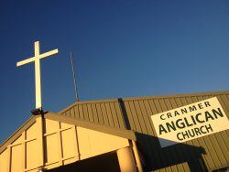
Day 9
Parish of Cohuna
Including: Cranmer the Martyr Cohuna, Latimer the
Martyr Leitchville, Christ Church, Gunbower
The Rev’d Sue Allen
Give thanks for
The Ecumenical initiatives and the sense of unity that we experience;
The children’s ministry that God is growing and sustaining ;
God’s sustaining love and faithfulness and our parishioner's faithfulness in giving both physically and financially.
Prayer points
For all those working and living in Aged Care Facilities, that God would be their shining light;
For the leadership of the Parish, that they will have God’s vision for sustainable future planning;
For all those Priest’s in parttime ministry – for the balancing of ministry demands – in particular our Rev. Sue.
Contact
Facebook: TheAnglicanParishofCohuna;
Rev'd Sue Allen
sueallen614@outlook.com
0417 365 386
The Rev’d Sue Allen
Also pray for:
Diocese of Newcastle

Slide 14
Day 10
Parish of Daylesford
God blesses those who hunger and thirst for justice, for they will be
satisfied. – Matthew 5: 6
The Rev. Neil Fitzgerald
Give thanks for
Our diverse, multi-national, inclusive and accepting Parish;
The continued work of our Ladies’ Guild, Archiving Project Team and Stanbridge Centre Building Committee;
Our Parish Maintenance Team who upkeep our grounds and gardens, Church, Hall and Rectory preserving our history and heritage.
Prayer points
Our work with the local refugee agencies, supporting refugee rights and other important campaigns;
Local services and our parish’s work to support the homeless providing clothing, blankets and essential items for winter;
The Gay&Pray Ministry based in Daylesford raising awareness of LGBTIQ issues including acceptance, inclusion in Church life and suicide prevention.
Contact
0491 604 613
info@daylesfordanglican.com
Rev’d Neil Fitzgerald vicar@daylesfordanglican.com
Also pray for:
Aboriginal and Torres Strat Islander Ministry in the Diocese

Slide 15
Day 11
Without counsel plans fail, but with many advisers they succeed. –
Proverbs 15: 22
Diocesan Governance and Leadership
Give thanks for
Bishop in Council;
Diocesan Executive & Senior Leadership Team;
Finance Committee;
Those who serve on sub-committees and other Diocesan bodies.
Prayer points
Archdeacons- Ven. Peter Blundell & Ven. George Hemmings; and Rural Deans Fr. Simon Robinson (Campaspe), Rev’d Tracey Wolsey (Bendigo East), Rev’d Canon Ian Howarth (Mount Alexander), Rev’d Sue Allen (Loddon);
Ministry Development Office as they provide training for clergy and learning opportunities for lay people in the Diocese.
Continued wisdom for the planning and oversight of the Diocese.
Contact
reception@bendigoanglican.org.au mdo@bendigoanglican.org.au
Also pray for:
Clergy Households and Widows

Slide 16
Day 12
Parish of Echuca
For what I received I passed on to you as of first importance: that Christ died for our sins according to the Scriptures, that he was buried, that he was raised on the third day according to the Scriptures. 1 Cor 15:3,4
The Rev’d Phil Zamagias
Give thanks for
The ministry of Rev'd Phil;
A renewed vision for ministry & oversight of the Moama parish;
Increasing lay involvement in ministry within the church and parish.
Prayer points
That we will grow in our knowledge and love of Jesus and that we will be effective in sharing the gospel;
For relationships and community contacts;
For the development of inter-denominational partnerships that will enhance our witness to the community.
Contact
03 5482 1105
info@christchurchechuca.org www.christchurchechuca.org
Rev’d Phil Zamagias-0403 750 926 phil@christchurchechuca.org
Also pray for: Diocese of Perth
Pioneer Ministries

Slide 17
Day 13
Parish of Elmore
Image: en.wikipedia.org
Including: St Peter’s Elmore, St John’s Colbinabbin, St George’s
Goornong, St Mary’s Raywood
The Rev’d Peter Downes
Give thanks for
The privilege of being able to gather in worship;
God’s provision for ministry;
God’s grace and mercy.
Prayer points
God’s continued wisdom and guidance for ministry in the area;
Deepening faith and relationship with Jesus;
Courage to share the gospel with friends and family;
Opportunity and resource to serve the broader community well.
Contact
Rev’d Peter Downes-0412957383
elmoreanglicanparish@gmail.com
Image: https://vhd.heritagecouncil.vic.gov.au/places/424
Also pray for:
Diocesan Communications

Slide 18
Day 14
Parish of Golden Square
Be joyful in hope, patient in affliction, faithful in prayer. – Romans 12: 12
The Rev’d Shannon Smith
Give thanks for
The privilege of being able to gather in worship;
God’s provision for ministry;
God’s grace and mercy.
Prayer points
God’s continued wisdom and guidance for ministry in the area;
Deepening faith and relationship with Jesus;
Courage to share the gospel with friends and family;
Opportunity and resource to serve the broader community well.
Contact
Rev’d Shannon Smith-0476 067 048
shannonsmith11@gmail.com
Also pray for:
Diocesan Finances

Slide 19
Day 15
Parish of Eaglehawk
We also pray that you will be strengthened with all his glorious power so you will have all the endurance and patience you need. May you be filled with joy, always thanking the Father. – Colossians 1: 11
The Rev’d Dale Barclay
Give thanks for
The new people who have joined our church and the wonderful ways in which they have brought new life and vitality;
Vision and will of our parish council to restore our buildings and make our plant future ready and fit for purpose;
The increase in our music team and the ways in which they are such a blessing to us in the times we gather for worship.
Prayer points
That God will bless our mission action plan so we may see an increase in numbers, strong disciples' pathways and the rejuvenation of our assets;
For the ongoing sustainability for our ‘Saltworks’ programs, particularly the community meals we provide;
That God will raise up new leaders and new ministries that we may be fully resourced and equipped for our part in God’s mission in our region.
Contact
Facebook: EaglehawkAnglican
Rev’d Dale Barclay-0428 456 677 dale.barclay@gmail.com
Also pray for:
Growing relationships between Bendigo Diocese and Diocese in other nations

Slide 20
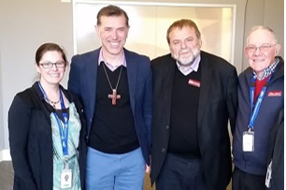
Day 16
Healthcare Chaplaincy
Image: www.bendigohealth.org.au
“I am leaving you with a gift—peace of mind and heart. And the peace I give is a gift the world cannot give. So don’t be troubled or afraid.” –
The Rev’d Terry Templer, The Rev’d Bertram Mather, & The Rev’d Peter Dyke
Give thanks for
John 14:27
The access to the hospitals and Aged Care facilities to provide Christian hope, comfort, a listening presence and Christian ritual where appropriate to patients, families and staff;
The funding provided by Bencourt to enable this ministry;
The support of Bishop Matt on behalf of the diocese and Karen Lunney, the Manager of Pastoral Care services and her team.
Prayer points
For continuing opportunities to bless & share the Gospel;
For wisdom to discern people’s needs and the appropriate response For the physical, spiritual and emotional strength and health for the task;
For the continuing good collegiality and mutual support of the multi-faith pastoral care team, for on-going professional development and support of the hospital executive.
Contact
Rev’d Terry Templer-0408 105 091 terrytempler@gmail.com
Karen Lunney (Manager Pastoral Care Services)
klunney@bendigohealth.org.au
Also pray for:
Diocese of Sydney

Slide 21
Day 17
Parish of Heathcote
“I am the light of the world. Whoever follows me will not walk in darkness, but will have the light of life.” – John 8: 12
Awaiting Appointment
Give thanks for
The fellowship that we have with each other in the Parish;
Faithfulness of parishioners;
God’s provision during difficult seasons.
Prayer points
Prayer for our Wednesday morning prayer and Tuesday Bible study to grow;
We are very small and we ask to be strengthened;
Pray for Buddies Op-Shop in seeking ways of becoming a blessing to the community and a place for people to hear about Jesus;
Unity with other Churches in Heathcote.
Contact
reception@bendigoanglican.org.au
Also pray for:
Diocese of Bunbury

Slide 22
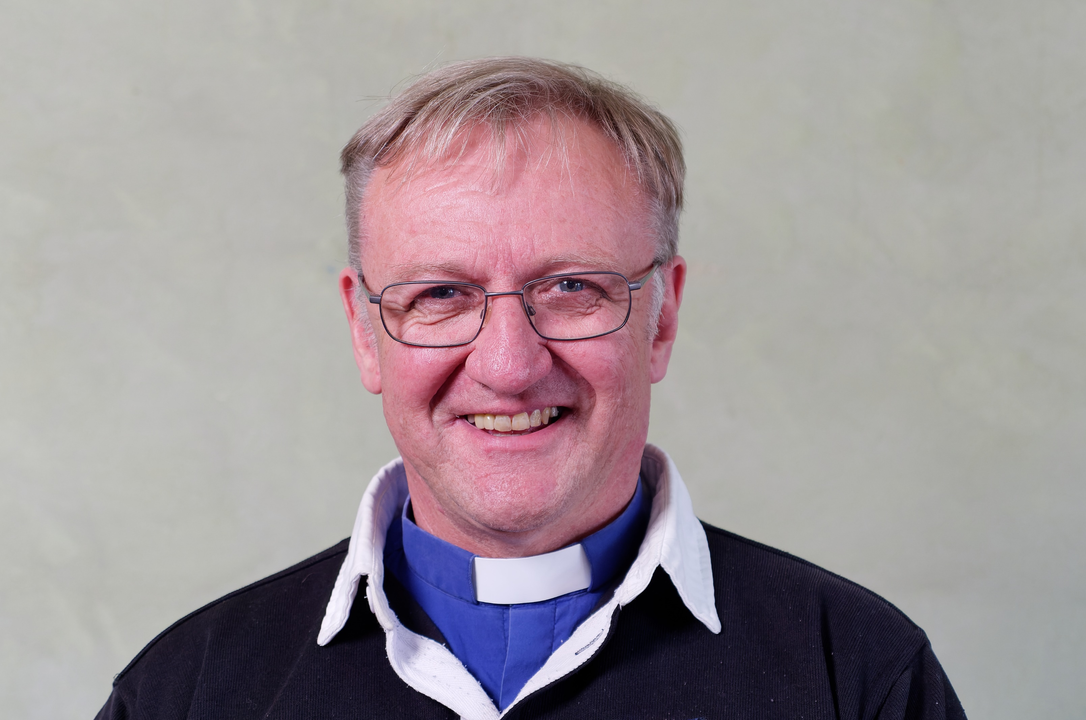
Day 18
House & Community Church
(Mallee-East Wimmera)
“In the same way, let your light shine before others, that they may see your good deeds and glorify your Father in heaven. In the same way, let your light shine before others, that they may see your good deeds and glorify your Father in heaven.” Matt 5:16
The Ven Peter Blundell
Give thanks for
The vision of a worshipping congregation in every community
The establishment of a prayer network
The establishment of a guiding framework to help lay leaders think through what might be needed in a given locality
Prayer points
Identifying and understanding local communities to focus time and energy to facilitate planting a congregation in a home or community facility
Safety in travel and vehicle reliability
For God to raise up hosts and worship leaders to work in partnership with the Loddon and Mallee clergy
Contact
The Ven. Peter Blundell-0427694720
riversidevenerable@gmail.com
Also pray for:
Diocese of Bunbury

Slide 23
Day 19
Parish of Inglewood
Including: Holy Trinity Bridgewater, St Augustine’s Inglewood and St
John’s Newbridge
The Rev’d Darcy Vaughan
Give thanks for
Each precious person in our congregation;
The community ministry The Bridge and the relationships it has built;
The growing connection to the Inglewood Hostel, its staff and residents.
Prayer points
That we would trust that God is at work;
That God would bless our communities and especially those who are searching for more;
That God would sustain in hope those who have served the church for many years.
Contact
Rev’d Darcy Vaughan-0407 245 951 maldoninglewood@gmail.com
Also pray for
Kooyoora

Slide 24
Day 20
Parish of Kangaroo Flat
We ask God to give you complete knowledge of his will and to give you spiritual wisdom and understanding. – Colossians 1: 9
Awaiting Appointment
Give thanks for
Our growing ministry beyond the walls with Traditional Hymns each week on 105.1 Life FM and our livestreaming and for God's abundant blessings in resourcing these ministries;
The people of the Parish who serve so faithfully and joyfully.
Prayer points
That we may continue to grow in love for God and one another;
That people would be drawn into this love;
That we might be a place of hope, love and light in our community.
Contact
03 5447 7427
anglicankf8@bigpond.com www.stmaryskangarooflat.com Facebook: AnglicanParishofStMary’s KangarooFlat
Also pray for:
Diocese of Adelaide

Slide 25
Day 21
Parish of Kerang
Awaiting Appointment
Give thanks for
The Ecumenical initiatives and the sense of unity that we experience;
The children’s ministry that God is growing and sustaining ;
God’s sustaining love and faithfulness and our parishioners faithfulness in giving both physically and financially.
Prayer points
For all those working and living in Aged Care Facilities, that God would be their shining light;
For the lay leadership of the Parish, that they will have God’s vision for sustainable future planning;
For the parish in a period of transition and for God's leading in future arrangements.
Contact
Facebook: StJohn’sAnglicanChurchKerang
gannawarra.anglican@gmail.com
Also pray for:
Diocese of Newcastle

Slide 26
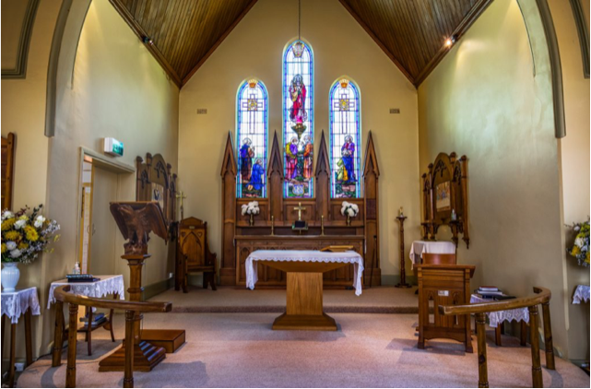
Day 22
Parish of Kyabram
Always be joyful. Never stop praying. Be thankful in all circumstances, for this is God’s will for you who belong to Christ Jesus. – 1 Thes 5: 16 - 18
The Rev’d Jacob Kelly
Give thanks for
The families and children which have joined the parish in the last year!
The next generation of Christians serving in our parish;
God’s mercy and providence during the floods.
Prayer points
For God to speak during the many funerals and pastoral services in our parish;
For the church as it seeks to support our children and families;
That we would be effective at making disciples.
Contact www.kyabramanglican.org.au office.kyabramanglican@gmail.com 33 Church Street, Kyabram, VIC 3620
Rev’d Jacob Kelly-0499 308 450
minister.kyabramanglican@gmail.com
Also pray for:
Anglicare Victoria

Slide 27
Day 23
Parish of Kyneton -
Malmsbury
Instead, you must worship Christ as Lord of your life. And if someone asks about your hope as a believer, always be ready to explain it. – 1 Peter 3: 15
The Rev’d Wayne Landford
Give thanks for
Rev’d Wayne’s ministry;
The wonderful people of Kyneton and Malmsbury;
The ability to gather together again both in worship and socially.
Prayer points
For all those in our community;
For the opportunity to show God’s love in the wider community;
For those experiencing homelessness as we move into winter.
Contact kyneton.anglicans@gmail.com www.kynetonanglicans.org
Rev’d Wayne Landford 0422 557 569 revd.wayne.landford@gmail.com
Also pray for:
Victorian Council of Churches

Slide 28
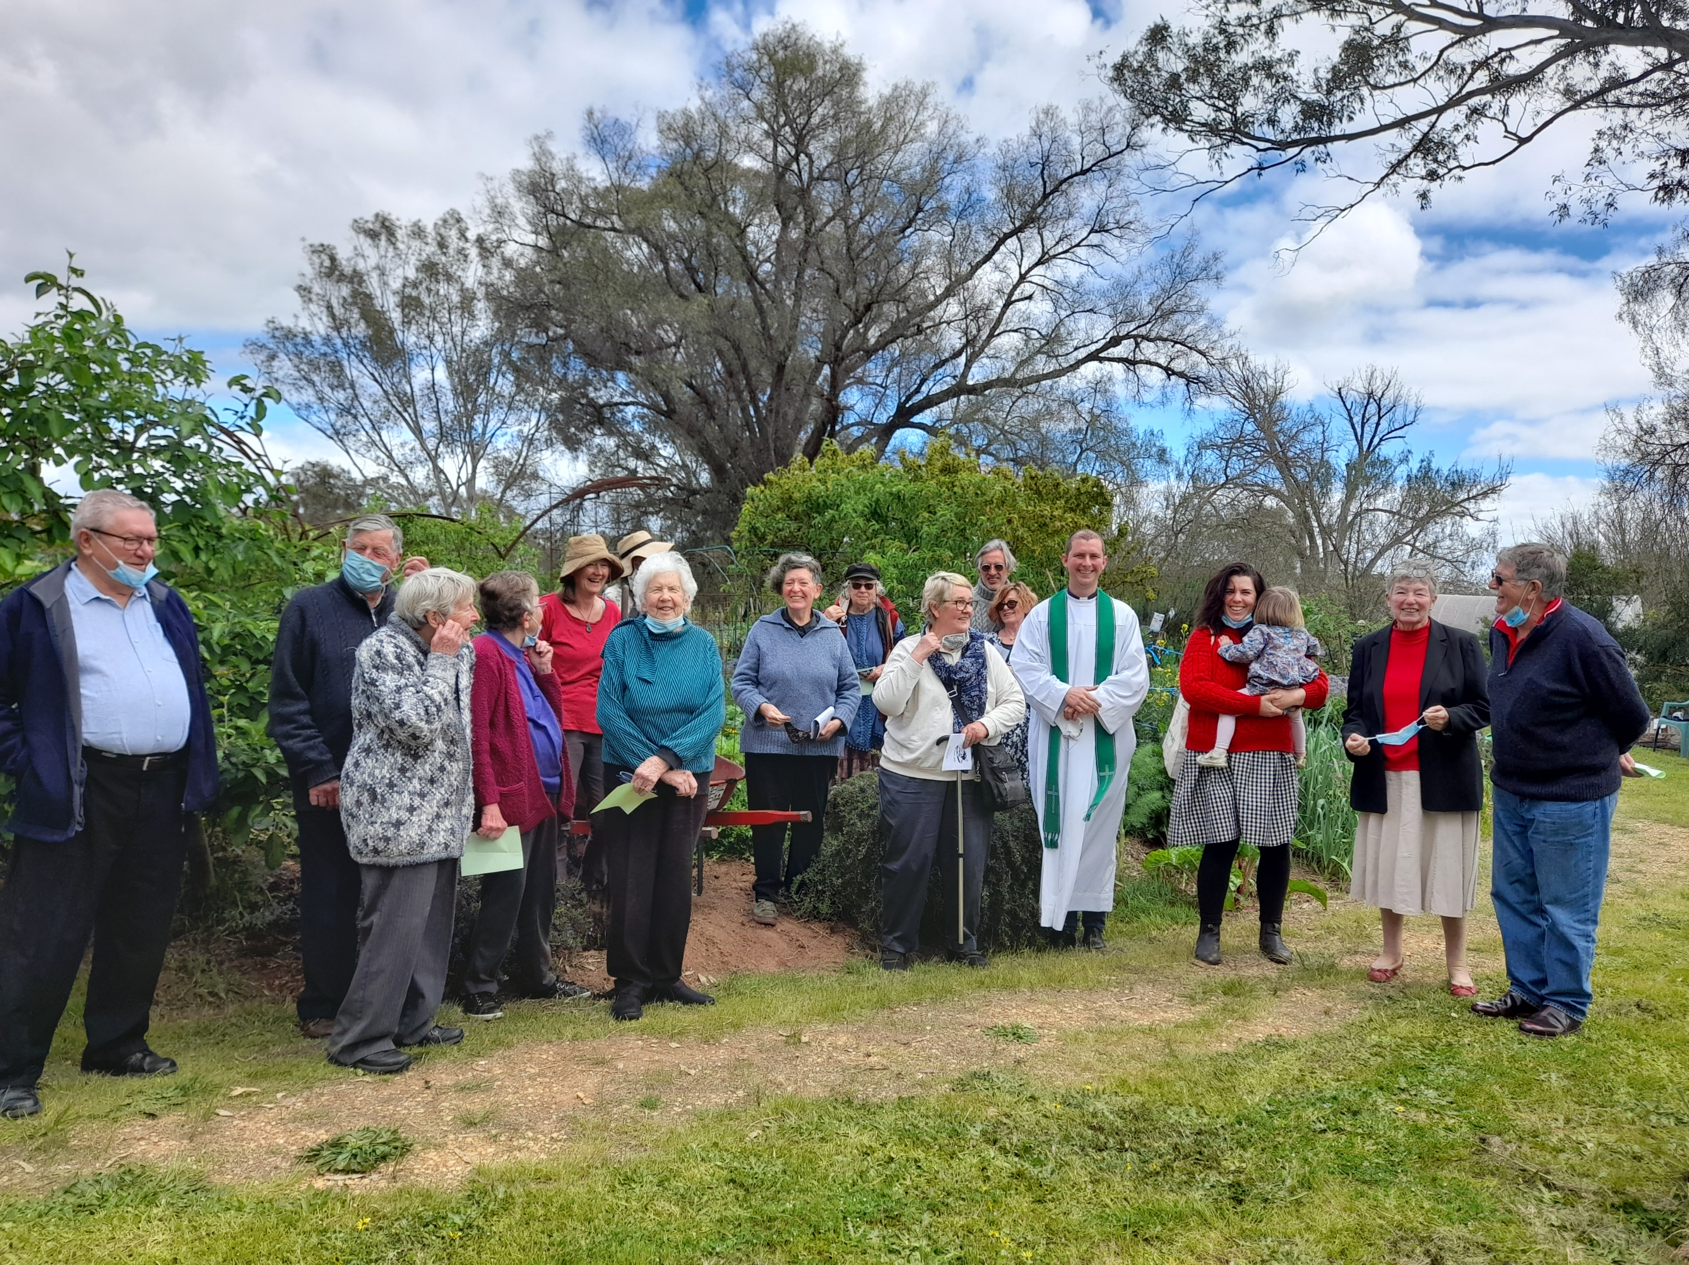
Day 24
Parish of Maldon
Including: Holy Trinity Maldon and All Saints’ Newstead
The Rev’d Darcy Vaughan
Give thanks for
Opportunities to engage with and participate in our vibrant community;
The dedicated commitment of those in the congregation;
Plans to begin a kids ministry in 2023.
Prayer points
Opportunities to demonstrate our distinctiveness as followers of Jesus;
For God’s guidance and blessing as we seek to begin a Kids Club one afternoon a week;
For wisdom to know how to hold on to what is good and be open to change as we welcome new people to engage with the church.
Contact
maldonnewsteadap@gmail.com
Rev’d Darcy Vaughan-0407 245 951 maldoninglewood@gmail.com
Also pray for:
Diocese of Melbourne

Slide 29
Day 25
Parish of Maryborough with
Avoca
Including: Christ the King Maryborough, St John’s Dunolly, St Michael & All Angels Talbot, St John the Divine Avoca, St
Mark’s Elmhurst, St Paul’s Moonambel
The Rev’d Canon Heather Blackman
Give thanks for
Growth in discipleship, generosity and compassion;
Anglicare in Maryborough and their ministry to those in need;
Our willingness to look into a new way forward for the people of God in our Parish.
Prayer points
A renewed energy in the Parish and the building up of the ministry of all the baptised;
Outreach ministries to reflect God's love in the community;
For our move to a sustainable and cohesive Parish into the future.
Contact
03 5460 5964
maryborough.anglican@outlook.com
Also pray for:
Youth Ministries throughout the diocese & strengthening of faith for young people

Slide 30
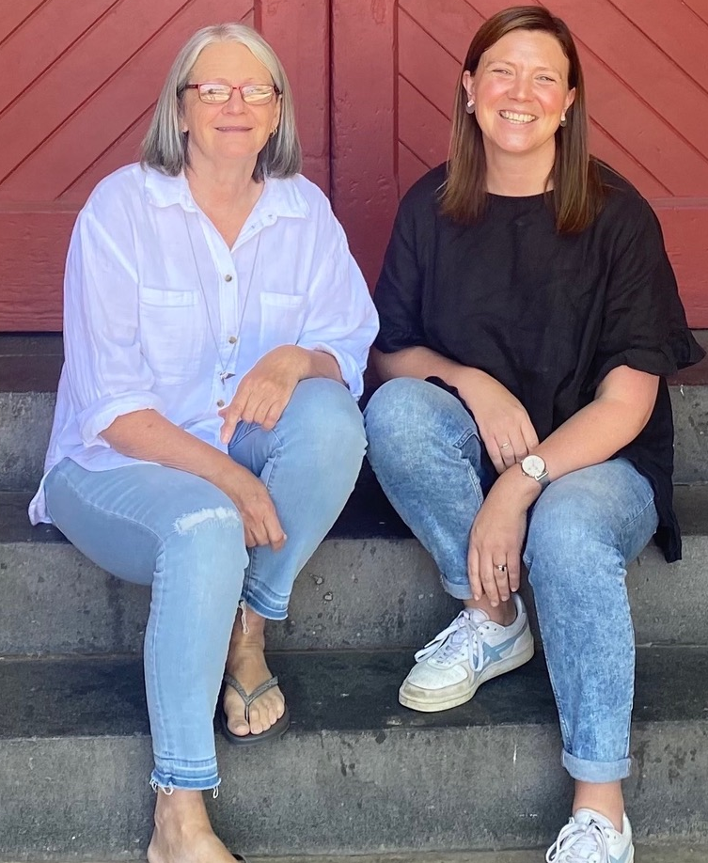
Day 26
Community Chaplaincy -
MinisTree
Image: www.bendigo.vic.gov.au
MinisTree exists to provide care and a listening respectful presence on
the streets of Bendigo.
The Rev’d Tracey Wolsley & The Rev’d Fiona Preston
Give thanks for
God’s provision of Rev’d Tracey to work with Fiona. Praise God that Tracey and Fiona can go out on to the streets of the CBD together to offer chaplaincy to rough sleepers and those ‘doing it tough’ in Bendigo.;
The connections Tracey and Fiona are making with those on the street, for the trust being built and the stories being shared.;
Those who generously give to MinisTree Bendigo by way of food, finances and goods for the homeless. We thank God that He constantly provides so that we can give away to those less fortunate.
Prayer points
For the safety and warmth of those who will be spending tonight on the streets and doorways of the CBD.
For the conversations that Tracey and Fiona have with those they meet, that they will experience the love of God through them and will experience healing, joy and peace from these interactions and sharing their stories.
For protection for Tracey and Fiona and their families and for their prison chaplaincy (Loddon and Middleton & Tarrengower prisons ).
Contact
Rev’d Tracey Wolsley tracey@ministreebendigo.org.au
Rev’d Fiona Preston fiona@ministreebendigo.org.au
Also pray for:
Diocese of Rockhampton
Ministries of Family Life

Slide 31
Day 27
Ministry Development
We also pray that you will be strengthened with all his glorious power so you will have all the endurance and patience you need. May you be filled with joy, always thanking the Father. – Colossians 1: 11
The Ven George Hemmings & The Rev’d Suzannah Daniels
Give thanks for
The privilege of ordained ministry to and with God’s people;
Growing opportunities to learn from each other and share skills both in person and online;
The Curnow Centre for Rural Ministry Training, a hub of learning and growing.
Prayer points
For the clergy and lay leaders across the diocese, may they be continually refreshed by the ‘renewing of their minds’;
For those who are discerning a call to ministry, preparing for ordination or newly ordained, may they find courage and closeness from Christ Jesus, each step of the way.
For the participants and tutors of the Australis Certificate of Ministry, may they grow in their ministry, faith and discipleship.
Contact
03 54434711
mdo@bendigoanglican.org.au
Also pray for:
Australian Government – local and federal

Slide 32
Day 28
Parish of Mooroopna
For we are God’s handiwork, created in Christ Jesus to do good works, which God prepared in advance for us to do. – Ephesians 2: 10
The Rev’d Simon Robinson
Give thanks for
The large influx of new converts and the curious;
Progress of, and provision for, significant building works to make our site more hospitable;
Spiritual growth of parishioners into leadership roles.
Prayer points
That our new people will be the seed that fell on good soil and produced abundantly [a la parable of the Sower];
That the Holy Spirit continues to open up mission opportunities;
That the Holy Spirit is poured out in greater measure on our congregations.
Contact
03 5825 2031
Facebook: TeamSaintAlbans
Fr. Simon Robinson-0428 484 895 simon@mooroopnaanglican.com
Also pray for:
Diocese of North Queensland

Slide 33
Day 29
My Pilgrims
Way
Pioneer Ministry is about being able to gather people around who are outside the church for forming ecclesial relationships to encourage church - the body of Christ - to emerge.
Srebrenka Kunek
Give thanks for
Being enabled to sustain a ‘fresh expression’ of church, a form of church for our changing culture established primarily for the benefit of people not yet members of any church in the Diocese of Bendigo.
Prayer points
Assist me to creatively respond to the Holy Spirit’s initiatives with those outside the church; gathering them around me as they seek to establish new contextual Christian community both in digital ministry and in physical place.
Pray for Pioneer Ministry to be more readily recognised, supported and accepted.
Contact
Srebrenka Kunek, Ph.D. Principal, My Pilgrims Way Anglican Licensed Lay Pioneer Minister
0419 222 813 www.mypilgrimsway.org
srebrenka@mypilgrimsway.com
Also pray for:
Police & Prison Ministries

Slide 34
Day 30
New Horizons Welfare Services & Bencourt Care
“Truly I tell you, just as you did it to one of the least of these who are members of my family, you did it to me.” – Matthew 25:40
Give thanks for
The generosity of funding bodies that support NHWS projects;
The commitment and dedication of volunteers helping those in need;
The projects Bencourt has been able to support – Prison and Healthcare chaplaincy, Seeds, Renew et al.;
The relationships within Health Care and Prisons that allow Healthcare and Prison chaplaincy.
Prayer points
Wisdom for the Committee;
Fruitfulness in all projects supported;
Strengthening of relationships within the community.
Contact
03 5443 4711
reception@bendigoanglican.org.au
Also pray for:
Education system – private and public

Slide 35
Day 31
Parish of Northern Mallee
Including: St Margaret’s Mildura, St Peter’s Robinvale, St Martin’s Dareton (Riverina), and St John’s Wentworth (Riverina)
The Rev’d Joe Varghese
Give thanks for
God’s faithfulness;
The life of the faithfully departed. As they rest in the Lord and for their faithful service and outstanding contribution to our parish.
Prayer points
Ministry towards refugee families;
Church growth;
Wisdom, knowledge, and understanding as we minister to people.
Contact
03 5023 8265
Fr. Joe Varghese:-0472 718 570 rector@malleeanglican.org.au
Also pray for:
Diocese of Grafton

Slide 36
Day 32
Parish of Pyramid Hill/ Boort
Including: St Andrew’s Boort, St Thomas’ Pyramid Hill and St John’s Bears
Lagoon
The Rev’d Sue Allen
Give thanks for
Rural lifestyle;
Friendly communities;
The seasonal changes that bring variation to our lives;
Support -for the Kids Hope and KFC (Kids Friday Club) programs- from the East Loddon school.
Prayer points
Pyramids inter-denominational co-operation;
New growth throughout the parish;
Kids Hope and KFC (Kids Friday Club) continued program support by East Loddon school.
Contact Rev'd Sue Allen- 0417 365 386 sueallen614@outlook.com
Also pray for:
Raising up of new leaders

Slide 37
Day 33
Registry Team
The Word gave life to everything that was created, and his life brought
light to everyone. – John 1: 4
Archdeacon George, Bishop Matt, Sarah, Rev’d Zan, Debbie, Jenny, Jo, Mark & Paula
Give thanks for
The skills, experience and commitment of the team in the Registry;
Successful streamlining of our processes and systems;
Camaraderie enjoyed within the team.
Prayer points
Discernment as we continue to streamline and digitise our processes.
Grace to fulfil our role as an encouraging and supportive central point for the diocese.
Continued good health.
Contact
03 5443 4711
reception@bendigoanglican.org.au www.bendigoanglican.org.au
Also pray for:
Theological education and training institutions

Slide 38
Day 34
Parish of Rochester-
Lockington
Including: Holy Trinity, Rochester and St Mary’s, Lockington
The Rev’d Bertram Mather
Give thanks for
The opportunity to serve and encourage the community;
The faithfulness of the worshipping congregations.
Prayer points
For an increase in ecumenical ministry opportunities;
Deepening faith and relationship with Jesus;
Courage to share the gospel with friends and family.
Contact
Rev’d Bertram Mather-0469 295 162 mather_bertram@hotmail.com
Also pray for:
Bishops throughout the Worldwide Anglican Communion

Slide 39
Day 35
Parish of South-East Bendigo
For God has not given us a spirit of fear and timidity, but of power, love,
and self-discipline. – 2 Timothy 1: 7
The Rev’d Trevor Bell & The Rev’d Karen Reid & The Rev’d Andy Ellis
Give thanks for
The reforging of strong gospel focused small groups in our church;
The merging of our 8am service and 9:15am sercive to a 9:00am service, and that we are growing well together;
New leaders willing to be involved in our children and youth programs.
Prayer points
That we have God’s leading in the continuing of our outreach to university students over dinner;
That out church find our voice in sharing the gospel of Jesus to those in our spheres of influence; ;
That we continue to support one another and spur each other on in our discipleship.
Contact
03 5443 3482
office@southeastbendigo.com
Rev’d Trevor Bell 0400748007 trev@southeastbendigo.com Rev’d Karen Reid 0418492778 karen@southeastbendigo.com Rev’d Andy Ellis 0403909695 andy@southeastbendigo.com
Also pray for:
Anglican Religious Communities

Slide 40
Day 36
Parish of St Arnaud
Including: Christ Church Old Cathedral St Arnaud, All Saints’ Emu and
St David’s Bealiba
Awaiting Appointment
Give thanks for
Each parish member serving God faithfully;
Opportunities to minister in St Arnaud and Bealiba;
God's provision to enable ongoing ministry.
Prayer points
We pray for open hearts and minds to God’s leading;
We pray for ways to serve the young people and continued services at Kara Court and Coates Hostel;
We pray for wise stewardship of our beautiful buildings.
Archdeacon Peter Blundell-0427694720
riversidevenerable@gmail.com
Mr Bruce Sutherland-0497863182
bms3478@hotmail.com
Contact
Also pray for:
Service Relief Team

Slide 41
Day 37
Parish of Strathfieldsaye
I pray that your hearts will be flooded with light so that you can understand the confident hope he has given to those he called - his holy people who are his rich and glorious inheritance. – Eph 1: 18
The Rev’d Rob Edwards
Give thanks for
The new people who have joined our Parish and their willingness to be involved;
The opportunity to start a new worship service for families in our community;
Those in our Parish who serve so faithfully and joyfully.
Prayer points
That God will lead and guide us as we start our new family worship service.
That God will raise up new leaders and new ministries as we reach out to our wider community.
For the opportunity to be God’s hand and feet within the wider community.
Contact
Rev’d Rob Edwards-0412 571 139 strathfieldsayechurch@outlook.com
Also pray for:
Bishop to the Defence Forces and Anglican Defence Chaplains

Slide 42
Day 38
Parish of Sunraysia South
Pray that the Lord’s message will spread rapidly and be honoured wherever it goes, just as when it came to you. - 2 Thessalonians 3:1
Rev'd Steve Weickhardt (Mallee Missioner)
Give thanks for
Jesus Christ and that he has called us to be members of his church;
The ongoing support of Bush Church Aid;
The ministry of RENEW (foodbank, op-shop, community building) and the way our volunteers care for members of our community;
Our connections with the wider community.
Prayer points
Pray for a healthy culture of Bible reading, teaching and obeying in our congregation so that Jesus may be glorified;
Pray that Jesus may be proclaimed through the ministry of RENEW;
Pray for all those in leadership and ministry – that we may have a humble heart and seek to bring glory to Jesus in all we do.
Contact
03 5024 2521 office@aposs.org.au
Facebook: AnglicanParishofSunraysiaSouth
Rev'd Steve Weickhardt-0473 338 864 malleemission@outlook.com
Also pray for:
Diocese of Gippsland

Slide 43
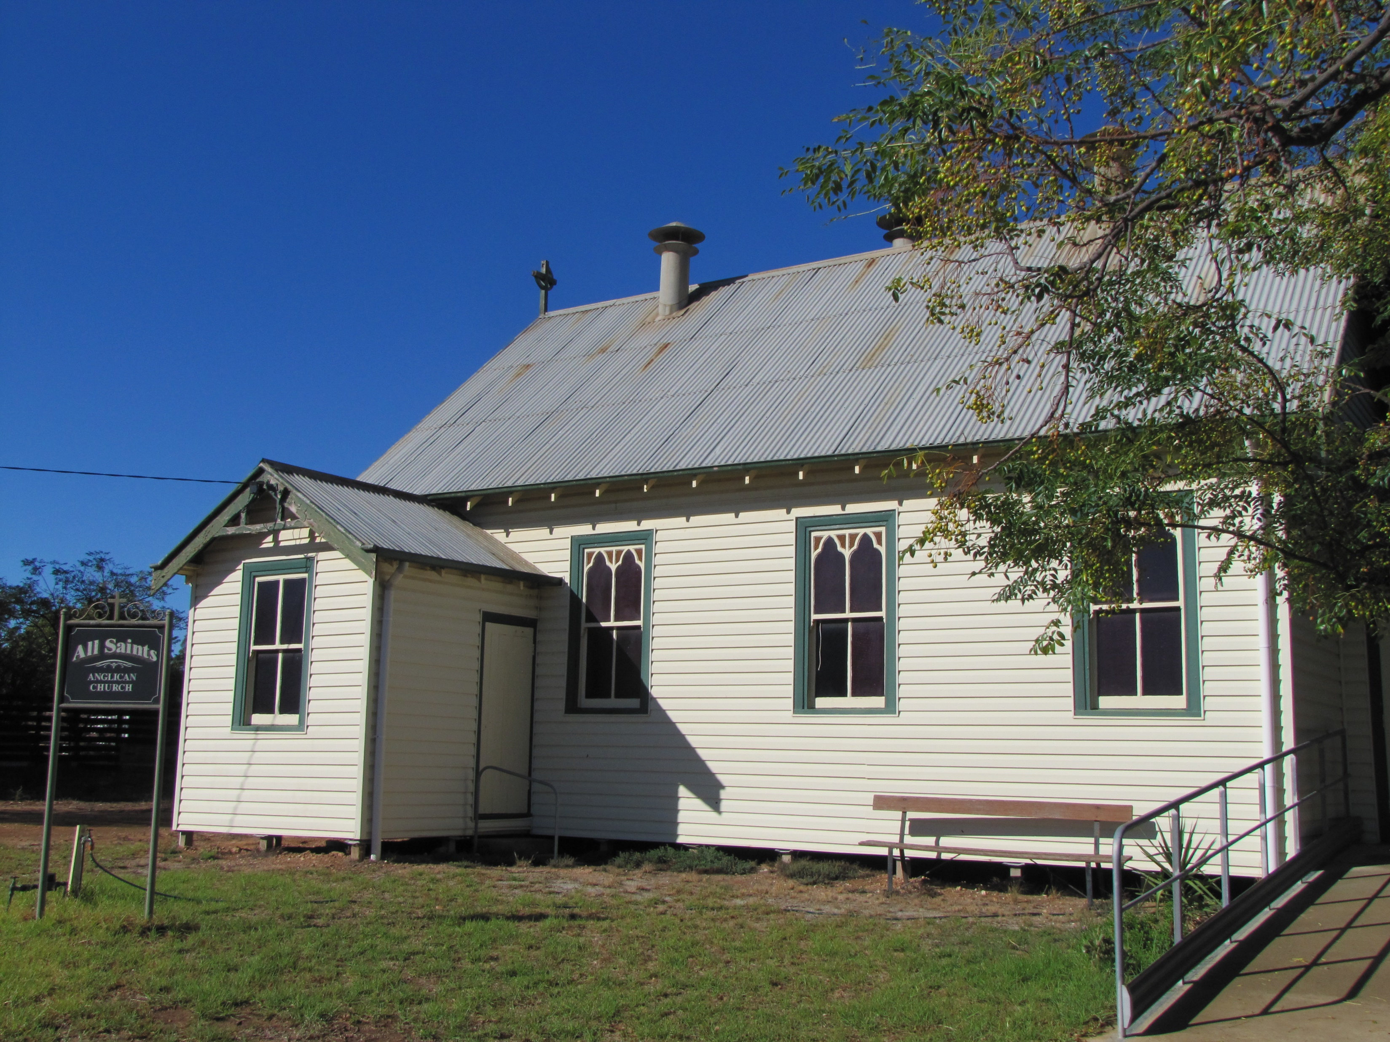
Day 39
Parish of Swan Hill
Including: Christ Church Swan Hill and All Saints’ Nyah West
Awaiting Appointment
Give thanks for
The ministry of assistant priest Denis;
Friendly links with the wider community especially through the Op Shop, Drop-in Centre and Men’s Shed at Nyah West, and the monthly car-boot sale and stalls at Swan Hill and the partnership with Anglicare;
God’s provision spiritually and materially during transition to a new incumbency.
Prayer points
For discernment how best to use people's gifts of hospitality in ministries of strengthening fellowship and outreach;
For provision of people and technology to strengthen the music ministry;
That God may call to ministry in this Parish a faithful pastor.
Contact
03 5032 2506
www.anglicanswanhill.com.au
Rev’d Denis Gell-0418226784
anglicansh@bigpond.com
Also pray for:
Diocese of Brisbane

Slide 44
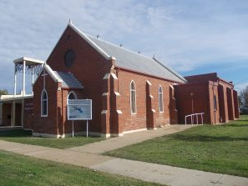
Day 40
Parish of Tatura
May the Lord lead your hearts into a full understanding and expression
of the love of God and the patient endurance that comes from Christ. – 2 Thessalonians 3: 5
Awaiting Appointment
Give thanks for
The privilege of being able to gather in worship and fellowship together;
Various opportunities of chaplaincy in our community (sport, local industry and cafes);
Being a welcoming community to visitors and new church members.
Prayer points
That Christ may be glorified daily in and through our lives;
That we may have joy in our lives and courage to share the gospel with friends and family;
That our Little Saints (children’s church) program may see more families added and for more volunteers who will help in discipling our children.
Contact
03 58782605
info@allsaintstatura.org.au allsaintstatura.org.au
Also pray for:
Cross-cultural ministries

Slide 45
Day 41
Parish of Tongala- Stanhope
For surely I know the plans I have for you, says the Lord, plans for your welfare and not for harm, to give you a future with hope.
– Jeremiah 29:11
The Rev’d Peter Dyke
Give thanks for
The privilege of gathering in worship and fellowship;
Regular ministry from clergy and lay leaders;
Our connections with the wider community.
Prayer points
God’s continued guidance for service into our communities;
Deepening personal faith and trust in Jesus;
The growth in volunteers and customers at our Op Shop;
Deepening our trust in God’s provision for our future.
Contact
Rev’d Peter Dyke-0458 101 032 peterdyke29@gmail.com
Also pray for:
Rural Communities

Slide 46
Day 42
Parish of Woodend &
Trentham
Praise be to the God and Father of our Lord Jesus Christ, who has blessed us in the heavenly realms with every spiritual blessing in Christ. –
Ephesians 1: 3
Awaiting Appointment
Give thanks for
Our communities and the beauty of the natural environment in the region;
The diversity of our communities and the opportunity to welcome all people to worship;
New families joining our parish community.
Prayer points
For people who are struggling to find work, or for those who are underemployed;
For the earth, for rain and sun in due seasons, and for good crops;
that we will continue to be places of welcome in the region and that all people will find comfort in prayer and worship in our churches.
Contact www.woodendanglican.org.au Facebook: WoodendAnglican
Also pray for:
Diocese of Canberra & Goulburn

Slide 48
4 Myers Street, Bendigo, Vic 3552
P: 03 5443 4711
E: reception@bendigoanglican.org.au

